Slide 1
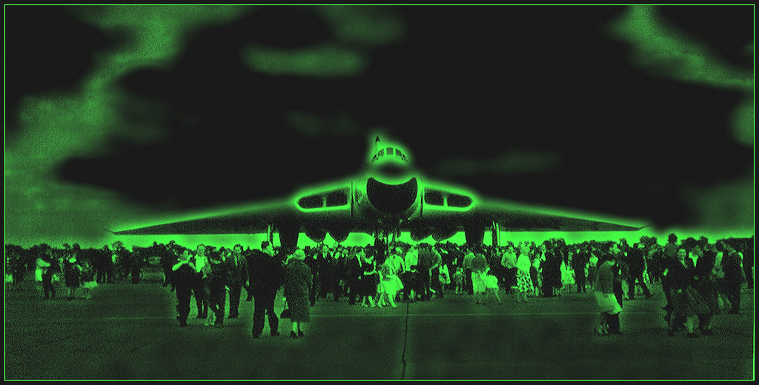
NIGHT VISION TECHNOLOGY
Name: Rajat Rajesh Minekar
Roll No:21444

Slide 2
…TABLE OF CONTENTS…
Types of Night Vision
Working of Technical Night Vision
Night Vision Devices
Generations
Applications
Conclusion
Reference

Slide 3
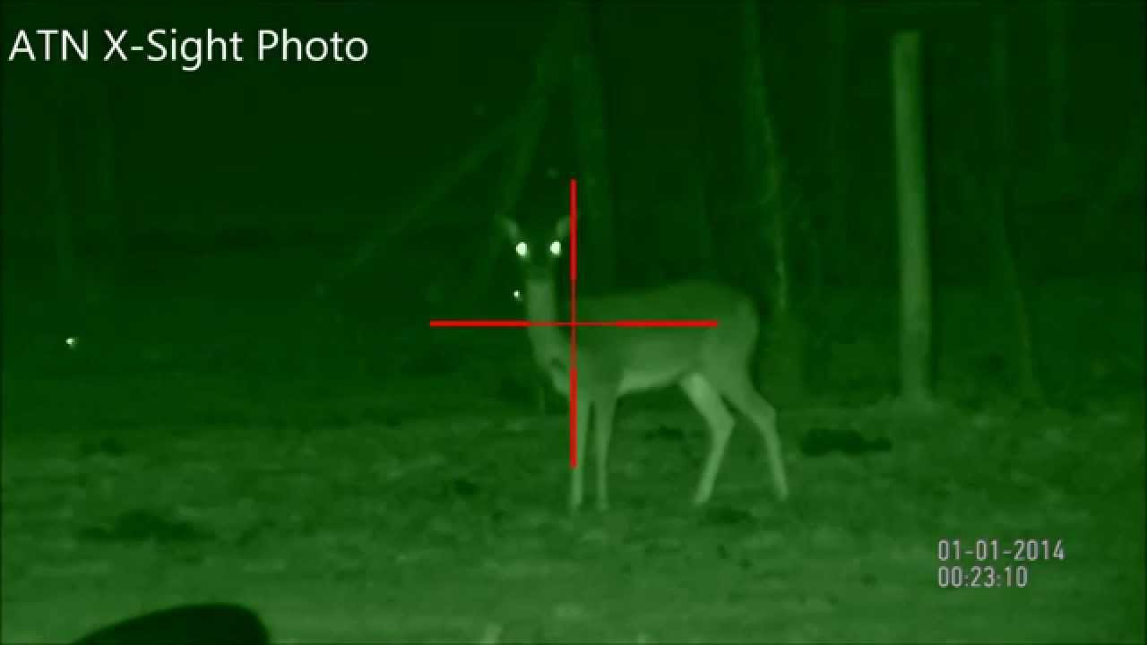
INTRODUCTION
• Night vision technology, literally allows one to see in the dark.
• It is originally developed for military use .
• Humans have poor night vision compared to many other animals.
• With the proper night-vision equipment, we can see a person standing over 200 yards (183 m) away on a moonless, cloudy night.

Slide 4
TYPES OF NIGHT VISION
It is broadly classified into two types
Biological Night Vision
• Molecules in the rods of the eye undergo a change in shape as light.
• Molecules in the human rods is insensitive to the light.
Technical Night Vision
• Image intensifier
• Thermal imaging

Slide 5
WORKING OF TECHNICAL NIGHT VISION
Technical Night vision can work in two very different ways:
1. Image Intensifier
• Night vision amplifies light to achieve better vision .
• A conventional lens, captures ambient light.
• The gathered light is sent to the image-intensifier tube.
• The light energy released electron from the cathode and accelerated.
• These electrons enter micro channel plate and bounce off and generate more electron.

Slide 6
• Thousands of other electrons to be released in each channel.
• Original electrons collide with the channel , exciting atoms and causing other electrons.
• New electrons collide with other atoms, creating a chain.
• In image-intensifier tube, the electrons hit a screen.
• The energy of the electrons release photons and create green image on the screen.
• The green phosphor image is viewed through another lens.

Slide 7
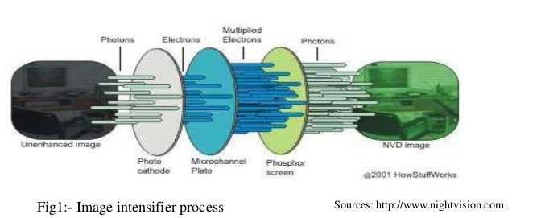

Slide 8
2. Thermal Imaging
All objects emit infrared energy as a function of their temperature.
• A lens focuses the infrared light.
• The focused light is scanned and create temperature pattern.
• The pattern created is translated into electric impulses.
• The impulses are sent to a circuit board that translates the information into data for the display.
• The signal-processing unit sends the information to the is play, and appears as various colors.
• Thermal images are black and white in nature.

Slide 9
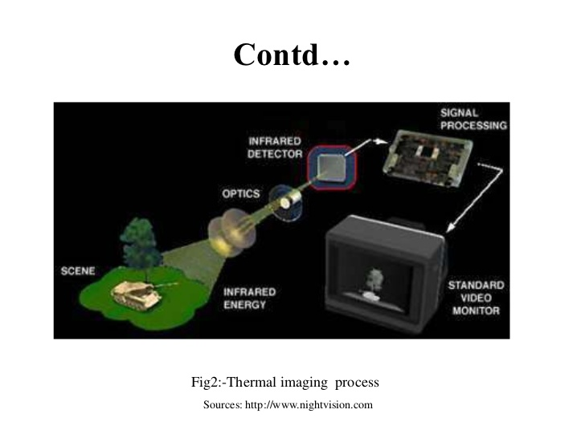

Slide 10
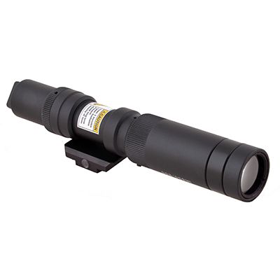
NIGHT VISION DEVICES
Night vision devices are basically divided into three categories
1.SCOPES
• They are monocular normally
handheld or mounted on a weapon.

Slide 11
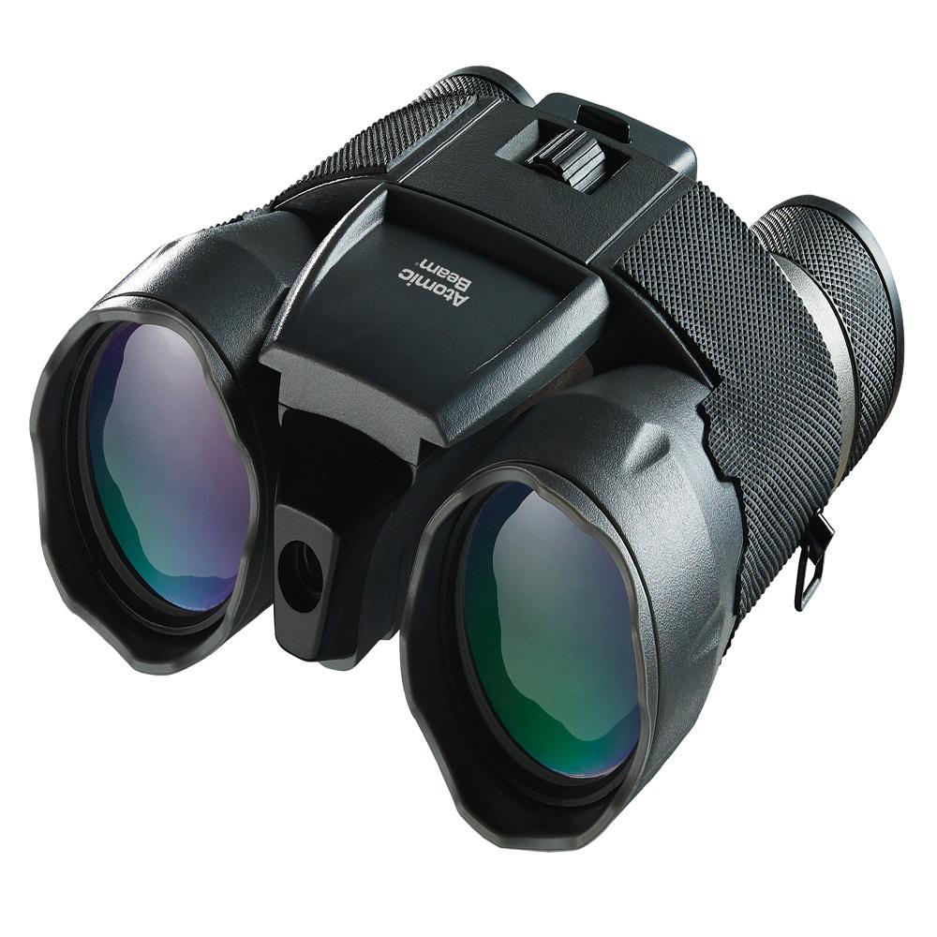
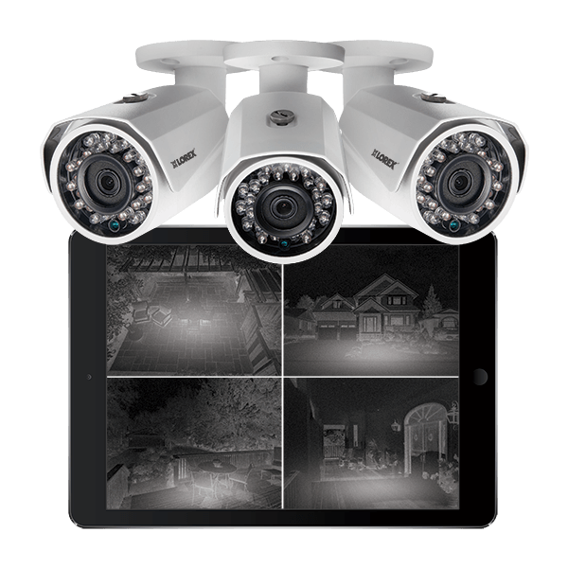
2.GOGGLES
• They are binocular and worn on the head.
3.CAMERAS
• Used for transmission or recording of images mostly if the location is fixed.

Slide 12
GENERATIONS
1.Generation 0
The earliest (1950's) night vision products were based on image conversion, rather than intensification.
2.Generation 1
• Vacuum Tube Technology
• Full Moon Operation
• Amplification: 1,000
• Operating Life: 2,000 Hours

Slide 13
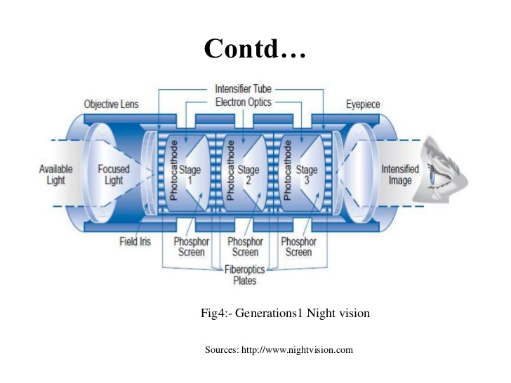

Slide 14
3.Generation 2
• First Micro channel Plate Application
• One-Quarter Moon Operation
• Amplification: 20,000
• Operating Life: 2,500 Hours
4.Generation3
• Improved Micro channel Plate & Photocathode
• Starlight Operation
• Amplification: 40,000
• Operating Life: 10,000 Hour

Slide 15
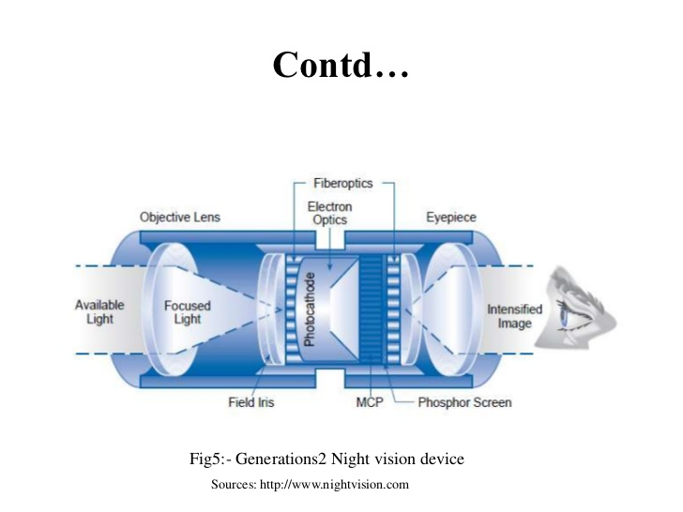

Slide 16

APPLICATIONS
• Military • Hunting

Slide 17
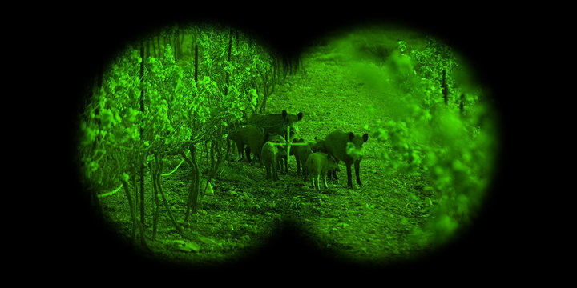
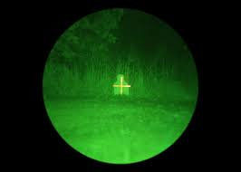
• Wildlife observation • Security
• Hidden-object detection

Slide 18
CONCLUSIONS
• Today in the 21st century we have come a long way in the development of night vision technology, from the early 1940’s.
• Night vision devices are basically designed for defensive purposes but the application within the scientific or the civilian range is also very help full.
• In present scenario the applications of night vision technology is very essential to combat terrorism which is a major problem being faced by mankind.

Slide 19
REFERENCES
• http://www.photonis.com/nightvision/products/supergen/super gen_specifications
• http://www.irinfo.org/articles/03_01_2007_grossman.html
• Www.Wikipedia.Org
• En.Wikipedia.Org/Wiki/Night_vision_device
• Www.Morovision.Com/How_thermal_imaging_works.Htm
• En.Wikipedia.Org/Wiki/Night_vision

Slide 20

THANK YOU.

Slide 21
